Slide 1

Sports Analytics I
Produced by Dr. Mario
UNC STOR 390

Slide 2
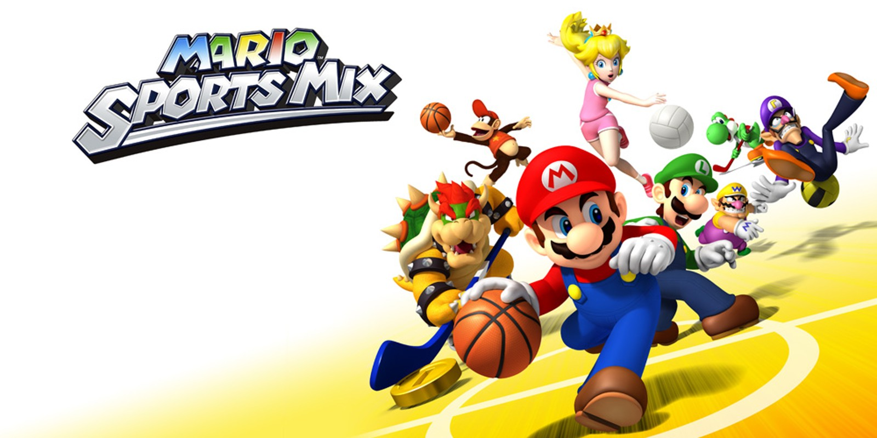
Survey Results: Demographics
30 Responses
Majority From the United States (29/30)
Majority From North Carolina (19/29)
Race Distribution
White (23/30)
Asian (4/30)
Black/African American (1/30)
Hispanic/Latino (1/30)

Slide 3
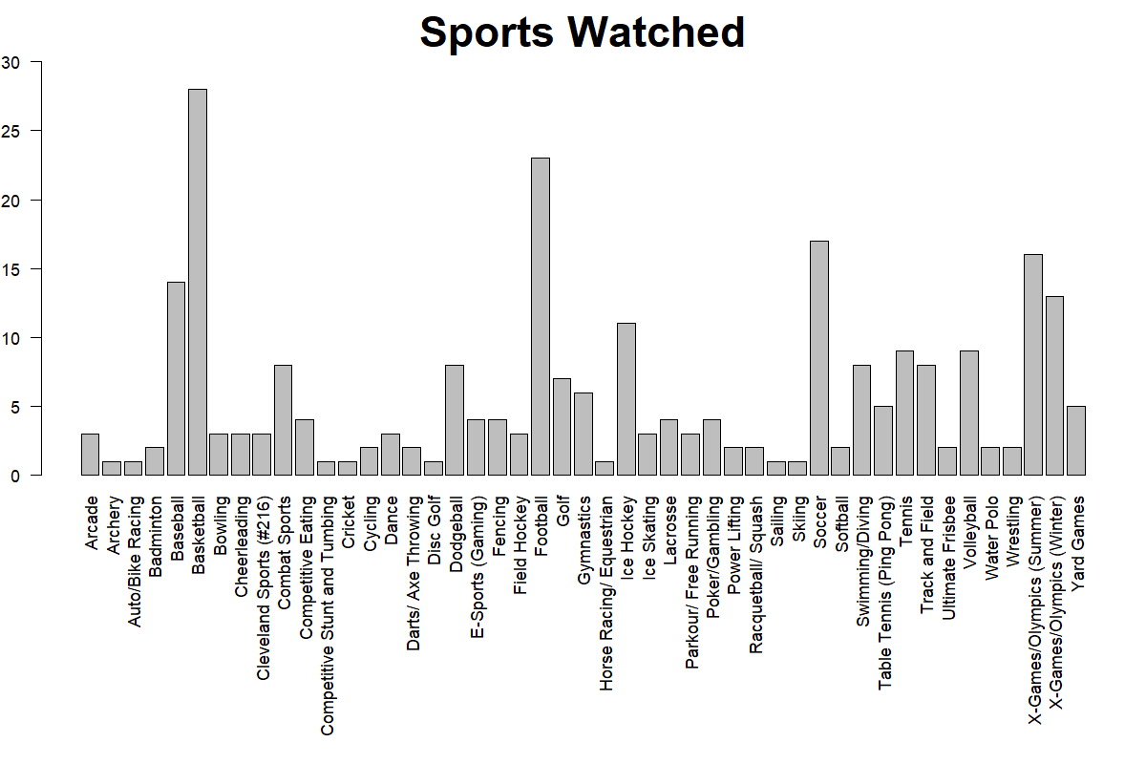
Survey Results: Watched

Slide 4
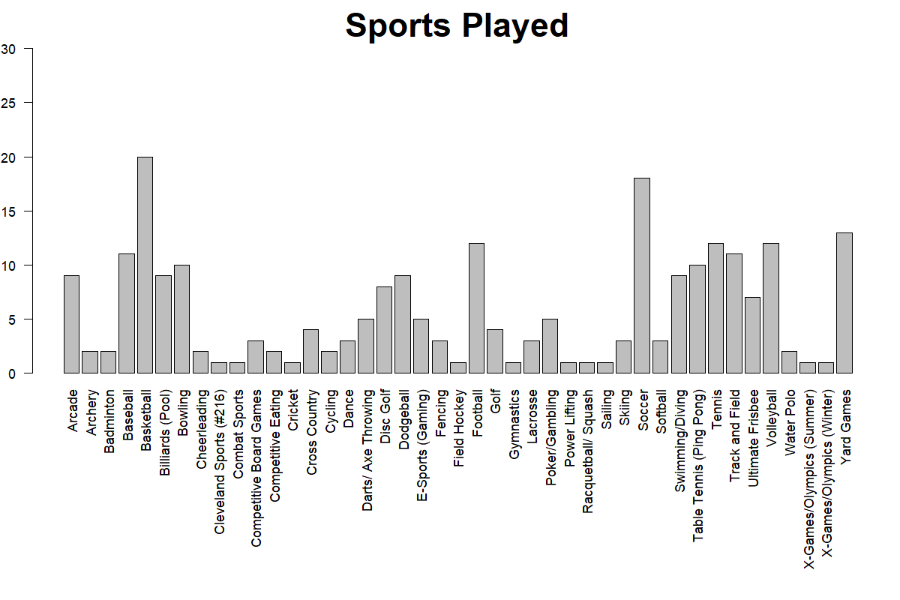
Survey Results: Played

Slide 5
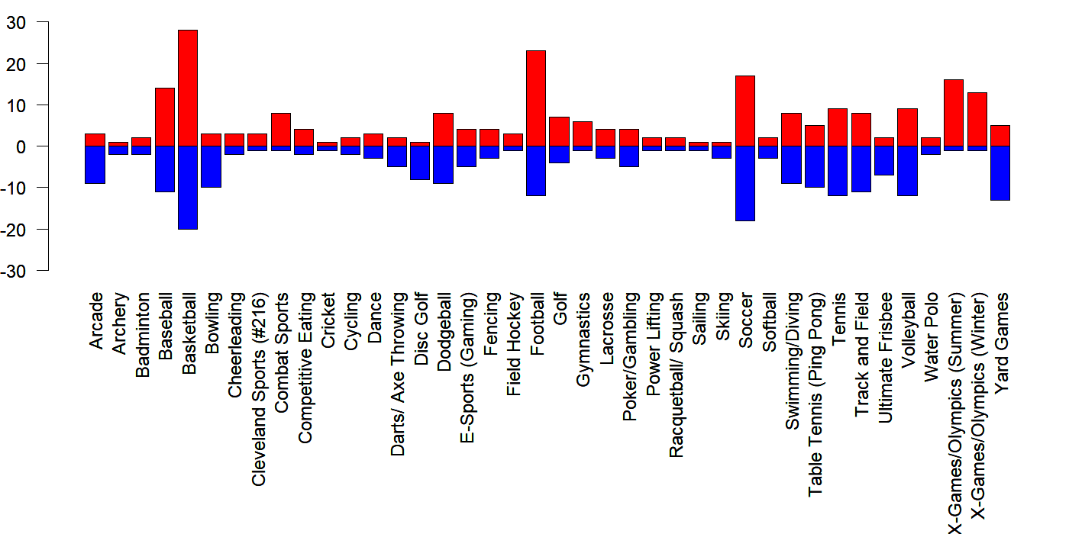
Survey Results: Combined

Slide 6
Current Landscape of Sports
Most Popular World Sports (sportsshow.net)
Based on 15 Criteria
Global Fan Base
Viewership on TV
TV Rights
Internet Popularity
Social Media Presence
Number of Professional Leagues
Average Salary of Athletes
Sponsorship
Number of Countries
Biggest Competition
Relevancy Throughout the Year
Gender equality
Access to the General Public
Number of Amateurs
Prominence in Headlines

Slide 7
Current Landscape of Sports
Most Popular World Sports (sportsshow.net)
Listed from Most to Least Popular
Soccer
Cricket
Basketball
Field Hockey
Tennis
Volleyball
Table Tennis
Baseball
American Football/Rugby
Golf

Slide 8
Current Landscape of Sports
Most Popular US Sports (sportsshow.net)
Based on TV Viewership
Listed from Most to Least Popular
Football (38.8% Favorite, 111.9 Million)
Baseball (14.8% Favorite, 40.0 Million)
Basketball (15.3% Favorite, 30.8 Million)
Ice Hockey (3.8% Favorite, 27.6 Million)
Soccer (8.2% Favorite, 27.3 Million)

Slide 9
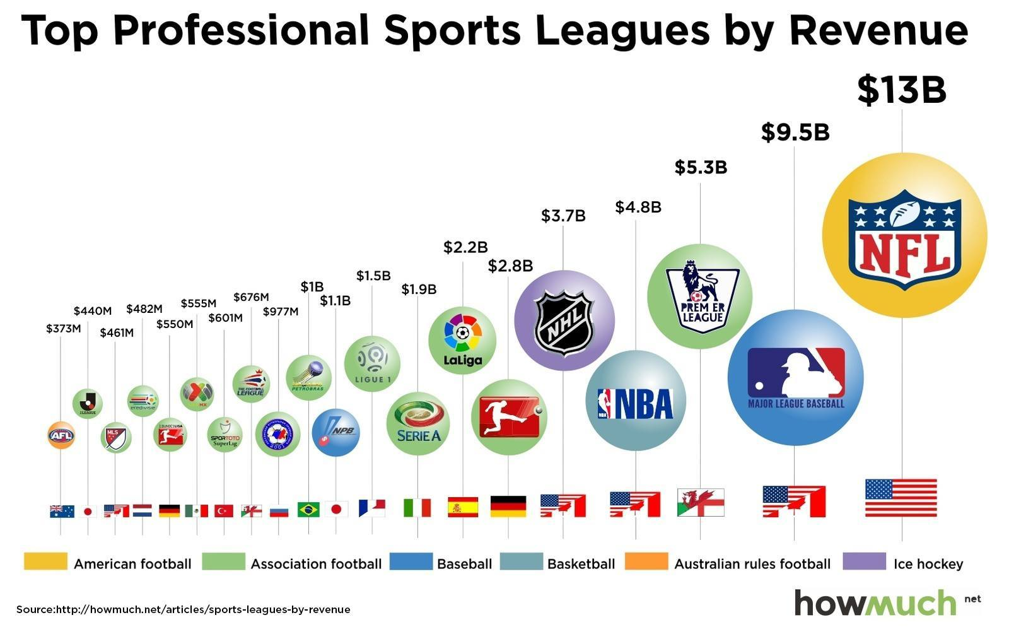
Current Landscape of Sports
Revenue in Sports Leagues (howmuch.net)

Slide 10
Current Landscape of Sports
Revenue in Sports Leagues (howmuch.net)
Majority Soccer Leagues (14/20)
Combined Soccer Leagues Revenue = $19.4B
MLS is 18th on the List = $461M
4 out of top 5 are US/Canadian Leagues
NFL, MLB, NBA, NHL = $31
US Diverse Interests = Spans 5 Different Sports

Slide 11
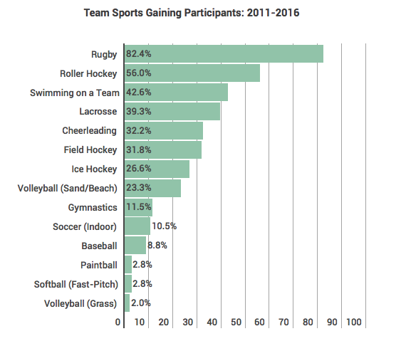
Current Landscape of Sports
Growth in Team Sports (sisugaurd.com)
Based on 2017 Annual Report
On US Trends in Team Sports
By Sports & Fitness Industry Association (SFIA)

Slide 12
Current Landscape of Sports
Growth in Team Sports (sisugaurd.com)
Increase of 10.9% Across All Sports (2014-2016)
Resilient Sports Based on Age of Participants
Soccer
Volleyball
Softball
Flag Football
Declining Sports Lost 9.3M Participants
Basketball Declined Most by 2.4M Participants

Slide 13
Dope Quote
The most meaningful way to
differentiate your company from your
competitors, the best way to put distance
between you and the crowd is to do an
outstanding job with information.
How you gather, manage, and use information
will determine whether you win or lose.
- Bill Gates

Slide 14
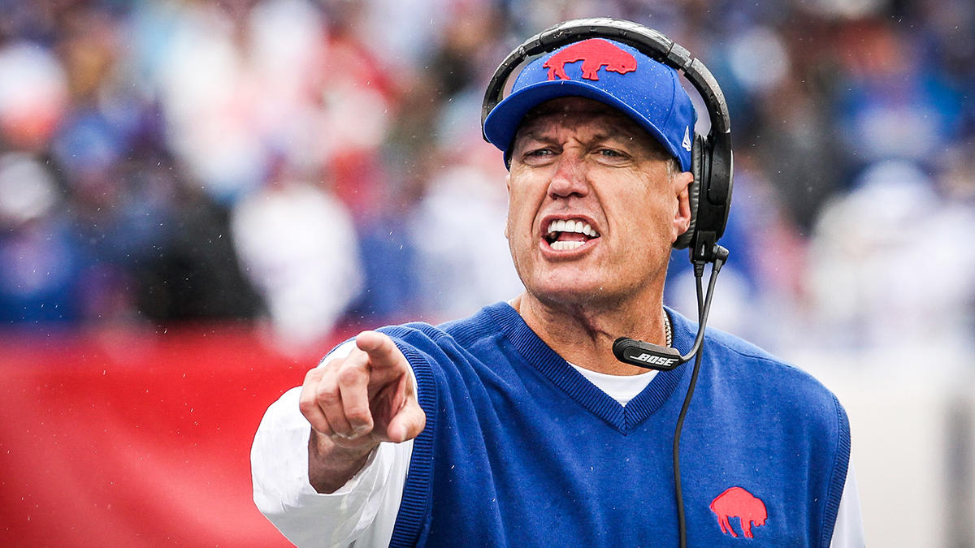
What is Sports Analytics?
Defined by Ben Alamar
Data Management
Predictive Models
Information Systems
Data
Management
Information
Systems
Analytic Models
Decision Maker
Based on Sports Analytics by Ben Alamar

Slide 15
What is Sports Analytics?
Purpose: To Aid an Organization’s Decision Makers in Gaining a Competitive Advantage
Goals
Save the Decision Maker Time by Making Information Acquisition Efficient
(Data Management/Information Systems)
Provide Decision Makers with Novel Insight
(Analytic Models)
We are an Accessory to the Decision Maker

Slide 16
What is Sports Analytics?
Different Decision Makers
Off-the-Field: Profit Driven
On-the-Field: Performance Driven
Skills for the Data Analyst
Competence – Ben Alamar
Leadership – Ben Alamar
Humility – Dr. Mario
Honesty – Dr. Mario

Slide 17
What is Sports Analytics?
Data Management
Different Sources: What are some examples?
Quantitative and Qualitative
Objective and Subjective
Text and Images and Video
Increasing Number of Sources
Increasing Volume from Those Sources
Data Needs to Be … “Organized”
“Centralized”
“Streamlined”

Slide 18
What is Sports Analytics?
Analytic Models
Consider the Research Question or Problem
Identify or Create Dependent Variables of Interest
Incorporate All Information
Find Relationships (Linear/Nonlinear)
Goal: “Meaningful Insight”

Slide 19
What is Sports Analytics?
Information Systems
Mechanisms for Data Delivery
Organization and Presentation Matters
“One Version of the Truth” – Summarized and Centralized
Static: Automatically Generated Reports
Interactive: Computer, Phone, Tablet, and Web Applications

Slide 20
Analytics In the Organization
On-the-Field
Coaching
Player Development
Player Evaluation
Off-the-Field
Sales
Marketing
Cap Management
Hiring
Public Relations and Social Media

Slide 21
Analytics Across the Organizations
Sports Analytics Use Survey (2013)
Sample of 27 People (NFL, MLB, NBA, EPL)
How Many Different Sources?
1-2 (6.7%)
3-4 (33.3%)
5-6 (13.3%)
>6 (46.71%)

Slide 22
Analytics Across the Organizations
How Much Data is Centralized?
All (31.3%)
Most (37.4%)
Some (31.3%)
How Much Data is Dependent on One Person?
Some (50.0%)
Most (43.7%)
All Data Centralized (6.3%)

Slide 23
Analytics Across the Organizations
Is Data Checked for Errors?
Always (31.3%)
Usually (37.5%)
Sometimes (18.8%)
Occasionally (6.1%)
Rarely (6.3%)
How Many Database Programmers are Employed?
0 (37.5%)
1-2 (50.0%)
3-4 (0.0%)
>5 (12.5%)

Slide 24
Analytics Across the Organizations
How Many Statistical Analysts are Employed?
0 (20.0%)
1-2 (66.6%)
3-4 (0.0%)
>5 (13.3%)
Roadblock: Difficulty Identifying Strong Applicant
Difficulty in Both Hiring and Evaluating

Slide 25
Analytics Across the Organizations
Clear Process for Hiring/Evaluating Analysts
Strongly Agree (13.3%/14.3%)
Somewhat Agree (13.3%/14.3%)
Neutral (26.7%/28.6%)
Somewhat Disagree (13.4%/21.4%)
Strongly Disagree (33.3%/21.4%)
Analytic Resources in Line with Strategic Game Plan
Strongly Agree (26.7%)
Somewhat Agree (33.3%)
Neutral (33.3%)
Strongly Disagree (6.7%)

Slide 26
Final Inspiration
If you’re not first, you’re Cleveland. #216
- Mahatma Mario

